Slide 1


Slide 2
WHAT
IS STATISTICS
STATISTICS IS A BRANCH OF MATHEMATICS THAT DEALS WITH COLLECTING, ANALYZING, INTERPRETING AND PRESENTING DATA

Slide 3
STATISTICS IS A BRANCH OF MATHEMATICS THAT DEALS WITH COLLECTING, ANALYZING, INTERPRETING AND PRESENTING DATA
WHAT
IS STATISTICS
MAKING SENSE OF NUMBERS AND FINDING PATTERNS IN DATA TO MAKE INFORMED DECISIONS

Slide 4

STATISTICS IS A BRANCH OF MATHEMATICS THAT DEALS WITH COLLECTING, ANALYZING, INTERPRETING AND PRESENTING DATA
WHAT
IS STATISTICS
MAKING SENSE OF NUMBERS AND FINDING PATTERNS IN DATA TO MAKE INFORMED DECISIONS
MAKING SENSE OF NUMBERS AND FINDING PATTERNS IN DATA TO MAKE INFORMED DECISIONS
KEY CONCEPTS OF STATISTICS

Slide 5
STATISTICS IS A BRANCH OF MATHEMATICS THAT DEALS WITH COLLECTING, ANALYZING, INTERPRETING AND PRESENTING DATA
MAKING SENSE OF NUMBERS AND FINDING PATTERNS IN DATA TO MAKE INFORMED DECISIONS
WHAT
IS STATISTICS
IS STATISTICS A NEW CONCEPT
ANCIENT BEGININGS
BIRTH OF MODERN STATISTICS
20TH CENTURY ADVANCES
STATISTICS IN DIGITAL AGE
KEY CONCEPTS OF STATISTICS

Slide 6
WHAT
IS STATISTIC?
STATISTICS IS A BRANCH OF MATHEMATICS THAT DEALS WITH COLLECTING, ANALYZING, INTERPRETING AND PRESENTING DATA
MAKING SENSE OF NUMBERS AND FINDING PATTERNS IN DATA TO MAKE INFORMED DECISIONS
KEY CONCEPTS OF STATISTICS
DATA COLLECTION:
THE PROCESS OF GATHERING INFORMATION
PRIMARY & SECONDARY METHOD OF DATA COLLECTION
SAMPLING METHOD
DATA QUALITY
CHALLENGES
DATA COLLECTION

Slide 7
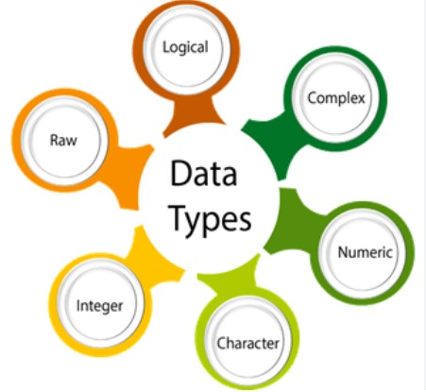
KEY CONCEPTS OF STATISTICS
WHAT
IS STATISTIC?
STATISTICS IS A BRANCH OF MATHEMATICS THAT DEALS WITH COLLECTING, ANALYZING, INTERPRETING AND PRESENTING DATA
MAKING SENSE OF NUMBERS AND FINDING PATTERNS IN DATA TO MAKE INFORMED DECISIONS
DATA COLLECTION
DATA TYPES:
QUANTITATIVE DATA
DISCRETE DATA
CONTINUOUS DATA
QUALITATIVE DATA
NOMINAL DATA
ORDINAL DATA
IMPORTANCE OF DATA TYPES
DATA COLLECTION:
THE PROCESS OF GATHERING INFORMATION
PRIMARY & SECONDARY METHOD OF DATA COLLECTION
SAMPLING METHOD
DATA QUALITY
CHALLENGES

Slide 8
KEY CONCEPTS OF STATISTICS
DATA COLLECTION:
THE PROCESS OF GATHERING INFORMATION
PRIMARY & SECONDARY METHOD OF DATA COLLECTION
SAMPLING METHOD
DATA QUALITY
CHALLENGES
WHAT
IS STATISTIC?
STATISTICS IS A BRANCH OF MATHEMATICS THAT DEALS WITH COLLECTING, ANALYZING, INTERPRETING AND PRESENTING DATA
MAKING SENSE OF NUMBERS AND FINDING PATTERNS IN DATA TO MAKE INFORMED DECISIONS
DATA COLLECTION
SAMPLING METHODS:
SIMPLE RANDOM SAMPLING
SYSTEMATIC SAMPLING
STRATIFIED SAMPLING
CLUSTER SAMPLING
CONVENIENCE SAMPLING

Slide 9
KEY CONCEPTS OF STATISTICS
WHAT
IS STATISTIC?
STATISTICS IS A BRANCH OF MATHEMATICS THAT DEALS WITH COLLECTING, ANALYZING, INTERPRETING AND PRESENTING DATA
MAKING SENSE OF NUMBERS AND FINDING PATTERNS IN DATA TO MAKE INFORMED DECISIONS
DATA COLLECTION
SAMPLING METHODS:
SIMPLE RANDOM SAMPLING
SYSTEMATIC SAMPLING
STRATIFIED SAMPLING
CLUSTER SAMPLING
CONVENIENCE SAMPLING
DATA COLLECTION:
THE PROCESS OF GATHERING INFORMATION
PRIMARY & SECONDARY METHOD OF DATA COLLECTION
SAMPLING METHOD
DATA QUALITY
CHALLENGES

Slide 10
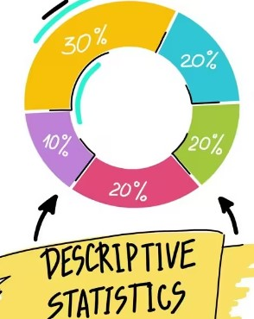
KEY CONCEPTS OF STATISTICS
DATA COLLECTION:
THE PROCESS OF GATHERING INFORMATION
PRIMARY & SECONDARY METHOD OF DATA COLLECTION
SAMPLING METHOD
DATA QUALITY
CHALLENGES
WHAT
IS STATISTIC?
STATISTICS IS A BRANCH OF MATHEMATICS THAT DEALS WITH COLLECTING, ANALYZING, INTERPRETING AND PRESENTING DATA
MAKING SENSE OF NUMBERS AND FINDING PATTERNS IN DATA TO MAKE INFORMED DECISIONS
DATA COLLECTION
DATA TYPES:
QUANTITATIVE DATA
DISCRETE DATA
CONTINUOUS DATA
QUALITATIVE DATA
NOMINAL DATA
ORDINAL DATA
IMPORTANCE OF DATA TYPES
DESCRIPTIVE STATISTICS:
MEAN – AVERAGE NUMBER
MEDIAN – MIDDLE NUMBER
MODE – FREQUENT NUMBER
RANGE – DIFFERENCE B/W HIGHEST & LOWEST
VARIANCE & STANDARD DEVIATION

Slide 11
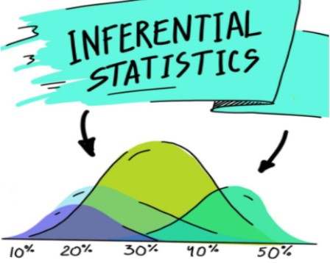
DATA TYPES:
QUANTITATIVE DATA
DISCRETE DATA
CONTINUOUS DATA
QUALITATIVE DATA
NOMINAL DATA
ORDINAL DATA
IMPORTANCE OF DATA TYPES
KEY CONCEPTS OF STATISTICS
DATA COLLECTION:
THE PROCESS OF GATHERING INFORMATION
PRIMARY & SECONDARY METHOD OF DATA COLLECTION
SAMPLING METHOD
DATA QUALITY
CHALLENGES
WHAT
IS STATISTIC?
STATISTICS IS A BRANCH OF MATHEMATICS THAT DEALS WITH COLLECTING, ANALYZING, INTERPRETING AND PRESENTING DATA
MAKING SENSE OF NUMBERS AND FINDING PATTERNS IN DATA TO MAKE INFORMED DECISIONS
DATA COLLECTION
DESCRIPTIVE STATISTICS:
MEAN – AVERAGE NUMBER
MEDIAN – MIDDLE NUMBER
MODE – FREQUENT NUMBER
RANGE – DIFFERENCE B/W HIGHEST & LOWEST
VARIANCE & STANDARD DEVIATION
INFERENTIAL STATISTICS:
POPULATION VS SAMPLE
SAMPLING METHODS
CENTRAL LIMIT THEOREM

Slide 12

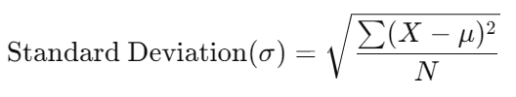
DATA TYPES:
QUANTITATIVE DATA
DISCRETE DATA
CONTINUOUS DATA
QUALITATIVE DATA
NOMINAL DATA
ORDINAL DATA
IMPORTANCE OF DATA TYPES
KEY CONCEPTS OF STATISTICS
DATA COLLECTION:
THE PROCESS OF GATHERING INFORMATION
PRIMARY & SECONDARY METHOD OF DATA COLLECTION
SAMPLING METHOD
DATA QUALITY
CHALLENGES
DESCRIPTIVE STATISTICS:
MEAN – AVERAGE NUMBER
MEDIAN – MIDDLE NUMBER
MODE – FREQUENT NUMBER
RANGE – DIFFERENCE B/W HIGHEST & LOWEST
VARIANCE & STANDARD DEVIATION
WHAT
IS STATISTIC?
STATISTICS IS A BRANCH OF MATHEMATICS THAT DEALS WITH COLLECTING, ANALYZING, INTERPRETING AND PRESENTING DATA
MAKING SENSE OF NUMBERS AND FINDING PATTERNS IN DATA TO MAKE INFORMED DECISIONS
DATA COLLECTION
VARIANCE & STANDARD DEVIATION
- Variance measures the average squared deviation of each data point from the mean.
Standard deviation is the square root of the variance. It provides a measure of the average distance from the mean.
INFERENTIAL STATISTICS:
POPULATION VS SAMPLE
SAMPLING METHODS
CENTRAL LIMIT THEOREM

Slide 13
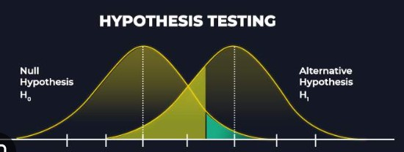
DESCRIPTIVE STATISTICS:
MEAN – AVERAGE NUMBER
MEDIAN – MIDDLE NUMBER
MODE – FREQUENT NUMBER
RANGE – DIFFERENCE B/W HIGHEST & LOWEST
VARIANCE & DTANDARD DEVIATION
DATA TYPES:
QUANTITATIVE DATA
DISCRETE DATA
CONTINUOUS DATA
QUALITATIVE DATA
NOMINAL DATA
ORDINAL DATA
IMPORTANCE OF DATA TYPES
KEY CONCEPTS OF STATISTICS
DATA COLLECTION:
THE PROCESS OF GATHERING INFORMATION
PRIMARY & SECONDARY METHOD OF DATA COLLECTION
SAMPLING METHOD
DATA QUALITY
CHALLENGES
WHAT
IS STATISTIC?
STATISTICS IS A BRANCH OF MATHEMATICS THAT DEALS WITH COLLECTING, ANALYZING, INTERPRETING AND PRESENTING DATA
MAKING SENSE OF NUMBERS AND FINDING PATTERNS IN DATA TO MAKE INFORMED DECISIONS
DATA COLLECTION
INFERENTIAL STATISTICS:
POPULATION VS SAMPLE
SAMPLING METHODS
CENTRAL LIMIT THEOREM
HYPOTHESIS TESTING:
NULL HYPOTHESIS (H0)
ALTERNATE HYPOTHESIS (H1)
TYPE I AND TYPE II ERROR
P- VALUE
COMMON TESTS

Slide 14
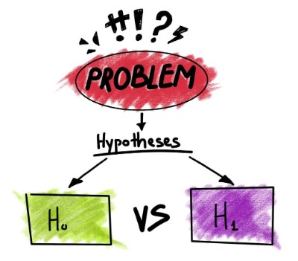
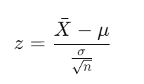
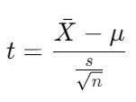
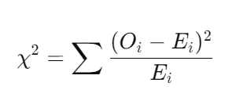

INFERENTIAL STATISTICS:
POPULATION VS SAMPLE
SAMPLING METHODS
CENTRAL LIMIT THEOREM
DESCRIPTIVE STATISTICS:
MEAN – AVERAGE NUMBER
MEDIAN – MIDDLE NUMBER
MODE – FREQUENT NUMBER
RANGE – DIFFERENCE B/W HIGHEST & LOWEST
VARIANCE & DTANDARD DEVIATION
DATA TYPES:
QUANTITATIVE DATA
DISCRETE DATA
CONTINUOUS DATA
QUALITATIVE DATA
NOMINAL DATA
ORDINAL DATA
IMPORTANCE OF DATA TYPES
KEY CONCEPTS OF STATISTICS
DATA COLLECTION:
THE PROCESS OF GATHERING INFORMATION
PRIMARY & SECONDARY METHOD OF DATA COLLECTION
SAMPLING METHOD
DATA QUALITY
CHALLENGES
WHAT
IS STATISTIC?
STATISTICS IS A BRANCH OF MATHEMATICS THAT DEALS WITH COLLECTING, ANALYZING, INTERPRETING AND PRESENTING DATA
MAKING SENSE OF NUMBERS AND FINDING PATTERNS IN DATA TO MAKE INFORMED DECISIONS
DATA COLLECTION
COMMON TESTS OF HYPOTHESIS TESTING:
Z- TEST
T- TEST
CHI- SQUARE TEST
ANOVA
HYPOTHESIS TESTING:
NULL HYPOTHESIS (H0)
ALTERNATE HYPOTHESIS (H1)
TYPE I AND TYPE II ERROR
P- VALUE
COMMON TESTS

Slide 15
INFERENTIAL STATISTICS:
POPULATION VS SAMPLE
SAMPLING METHODS
CENTRAL LIMIT THEOREM
DESCRIPTIVE STATISTICS:
MEAN – AVERAGE NUMBER
MEDIAN – MIDDLE NUMBER
MODE – FREQUENT NUMBER
RANGE – DIFFERENCE B/W HIGHEST & LOWEST
VARIANCE & DTANDARD DEVIATION
DATA TYPES:
QUANTITATIVE DATA
DISCRETE DATA
CONTINUOUS DATA
QUALITATIVE DATA
NOMINAL DATA
ORDINAL DATA
IMPORTANCE OF DATA TYPES
KEY CONCEPTS OF STATISTICS
HYPOTHESIS TESTING:
NULL HYPOTHESIS (H0)
ALTERNATE HYPOTHESIS (H1)
TYPE I AND TYPE II ERROR
P- VALUE
COMMON TESTS
DATA COLLECTION:
THE PROCESS OF GATHERING INFORMATION
PRIMARY & SECONDARY METHOD OF DATA COLLECTION
SAMPLING METHOD
DATA QUALITY
CHALLENGES
WHAT
IS STATISTIC?
STATISTICS IS A BRANCH OF MATHEMATICS THAT DEALS WITH COLLECTING, ANALYZING, INTERPRETING AND PRESENTING DATA
MAKING SENSE OF NUMBERS AND FINDING PATTERNS IN DATA TO MAKE INFORMED DECISIONS
DATA COLLECTION
COMMON TESTS OF HYPOTHESIS TESTING:
Z- TEST
T- TEST
CHI- SQUARE TEST
ANOVA

Slide 16

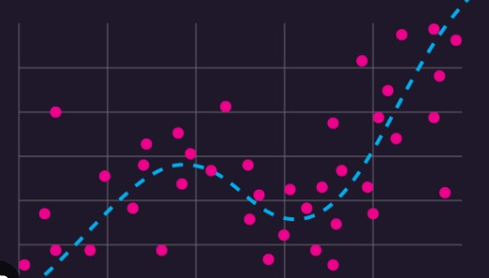



COMMON TESTS OF HYPOTHESIS TESTING:
Z- TEST
T- TEST
CHI- SQUARE TEST
ANOVA
HYPOTHESIS TESTING:
NULL HYPOTHESIS (H0)
ALTERNATE HYPOTHESIS (H1)
TYPE I AND TYPE II ERROR
P- VALUE
COMMON TESTS
INFERENTIAL STATISTICS:
POPULATION VS SAMPLE
SAMPLING METHODS
CENTRAL LIMIT THEOREM
DESCRIPTIVE STATISTICS:
MEAN – AVERAGE NUMBER
MEDIAN – MIDDLE NUMBER
MODE – FREQUENT NUMBER
RANGE – DIFFERENCE B/W HIGHEST & LOWEST
VARIANCE & DTANDARD DEVIATION
DATA TYPES:
QUANTITATIVE DATA
DISCRETE DATA
CONTINUOUS DATA
QUALITATIVE DATA
NOMINAL DATA
ORDINAL DATA
IMPORTANCE OF DATA TYPES
KEY CONCEPTS OF STATISTICS
DATA COLLECTION:
THE PROCESS OF GATHERING INFORMATION
PRIMARY & SECONDARY METHOD OF DATA COLLECTION
SAMPLING METHOD
DATA QUALITY
CHALLENGES
WHAT
IS STATISTIC?
STATISTICS IS A BRANCH OF MATHEMATICS THAT DEALS WITH COLLECTING, ANALYZING, INTERPRETING AND PRESENTING DATA
MAKING SENSE OF NUMBERS AND FINDING PATTERNS IN DATA TO MAKE INFORMED DECISIONS
DATA COLLECTION
REGRESSION ANALYSIS:
SIMPLE LINEAR REGRESSION
MULTIPLE LINEAR REGRESSION
LOGISTIC REGRESSION
CONFIDENCE INTERVAL
APPLICATIONS IN DATA SCIENCE:
EXPLORATORY DATA ANALYSIS
PREDICTIONS
PREDICTIVE MODELS
DECISION MAKING

Slide 17
REGRESSION ANALYSIS:
SIMPLE LINEAR REGRESSION
MULTIPLE LINEAR REGRESSION
LOGISTIC REGRESSION
RIDGE REGRESSION
LASSO REGRESSION
CONFIDENCE INTERVAL
COMMON TESTS OF HYPOTHESIS TESTING:
Z- TEST
T- TEST
CHI- SQUARE TEST
ANOVA
HYPOTHESIS TESTING:
NULL HYPOTHESIS (H0)
ALTERNATE HYPOTHESIS (H1)
TYPE I AND TYPE II ERROR
P- VALUE
COMMON TESTS
INFERENTIAL STATISTICS:
POPULATION VS SAMPLE
SAMPLING METHODS
CENTRAL LIMIT THEOREM
DESCRIPTIVE STATISTICS:
MEAN – AVERAGE NUMBER
MEDIAN – MIDDLE NUMBER
MODE – FREQUENT NUMBER
RANGE – DIFFERENCE B/W HIGHEST & LOWEST
VARIANCE & DTANDARD DEVIATION
DATA TYPES:
QUANTITATIVE DATA
DISCRETE DATA
CONTINUOUS DATA
QUALITATIVE DATA
NOMINAL DATA
ORDINAL DATA
IMPORTANCE OF DATA TYPES
KEY CONCEPTS OF STATISTICS
DATA COLLECTION:
THE PROCESS OF GATHERING INFORMATION
PRIMARY & SECONDARY METHOD OF DATA COLLECTION
SAMPLING METHOD
DATA QUALITY
CHALLENGES
WHAT
IS STATISTIC?
STATISTICS IS A BRANCH OF MATHEMATICS THAT DEALS WITH COLLECTING, ANALYZING, INTERPRETING AND PRESENTING DATA
MAKING SENSE OF NUMBERS AND FINDING PATTERNS IN DATA TO MAKE INFORMED DECISIONS
DATA COLLECTION
APPLICATIONS IN DATA SCIENCE:
EXPLORATORY DATA ANALYSIS
PREDICTIONS
PREDICTIVE MODELS
DECISION MAKING

Slide 18
REGRESSION ANALYSIS:
SIMPLE LINEAR REGRESSION
MULTIPLE LINEAR REGRESSION
LOGISTIC REGRESSION
RIDGE REGRESSION
LASSO REGRESSION
CONFIDENCE INTERVAL
COMMON TESTS OF HYPOTHESIS TESTING:
Z- TEST
T- TEST
CHI- SQUARE TEST
ANOVA
HYPOTHESIS TESTING:
NULL HYPOTHESIS (H0)
ALTERNATE HYPOTHESIS (H1)
TYPE I AND TYPE II ERROR
P- VALUE
COMMON TESTS
APPLICATIONS IN DATA SCIENCE:
EXPLORATORY DATA ANALYSIS
PREDICTIONS
PREDICTIVE MODELS
DECISION MAKING
INFERENTIAL STATISTICS:
POPULATION VS SAMPLE
SAMPLING METHODS
CENTRAL LIMIT THEOREM
DESCRIPTIVE STATISTICS:
MEAN – AVERAGE NUMBER
MEDIAN – MIDDLE NUMBER
MODE – FREQUENT NUMBER
RANGE – DIFFERENCE B/W HIGHEST & LOWEST
VARIANCE & DTANDARD DEVIATION
DATA TYPES:
QUANTITATIVE DATA
DISCRETE DATA
CONTINUOUS DATA
QUALITATIVE DATA
NOMINAL DATA
ORDINAL DATA
IMPORTANCE OF DATA TYPES
KEY CONCEPTS OF STATISTICS
DATA COLLECTION:
THE PROCESS OF GATHERING INFORMATION
PRIMARY & SECONDARY METHOD OF DATA COLLECTION
SAMPLING METHOD
DATA QUALITY
CHALLENGES
WHAT
IS STATISTIC?
STATISTICS IS A BRANCH OF MATHEMATICS THAT DEALS WITH COLLECTING, ANALYZING, INTERPRETING AND PRESENTING DATA
MAKING SENSE OF NUMBERS AND FINDING PATTERNS IN DATA TO MAKE INFORMED DECISIONS
DATA COLLECTION

